Slide 1
Border Crossing Analysis by Mode of Transport
A Comparative Look at Canadian and Mexican Borders
Javier Reyes, Hunter Katigbak, Jeremy Bentley, Michael Hennessy

Slide 2
Purpose of the Analysis
To analyze the volume of border crossings at U.S. borders with Canada and Mexico based on different modes of transport.
To highlight key trends and compare traffic patterns between the two borders.
To predict whether border crossings will increase or decrease using various machine learning methods. Random forest seemed to be the most accurate.

Slide 3
Data Overview
Data Sources: U.S. Customs and Border Protection
Time Period: 1996 – 2024
Key Variables:
Border: Canadian or Mexican.
Mode of Transport: Personal vehicles, pedestrians, trucks, trains, etc.
Count: Total crossings.

Slide 4
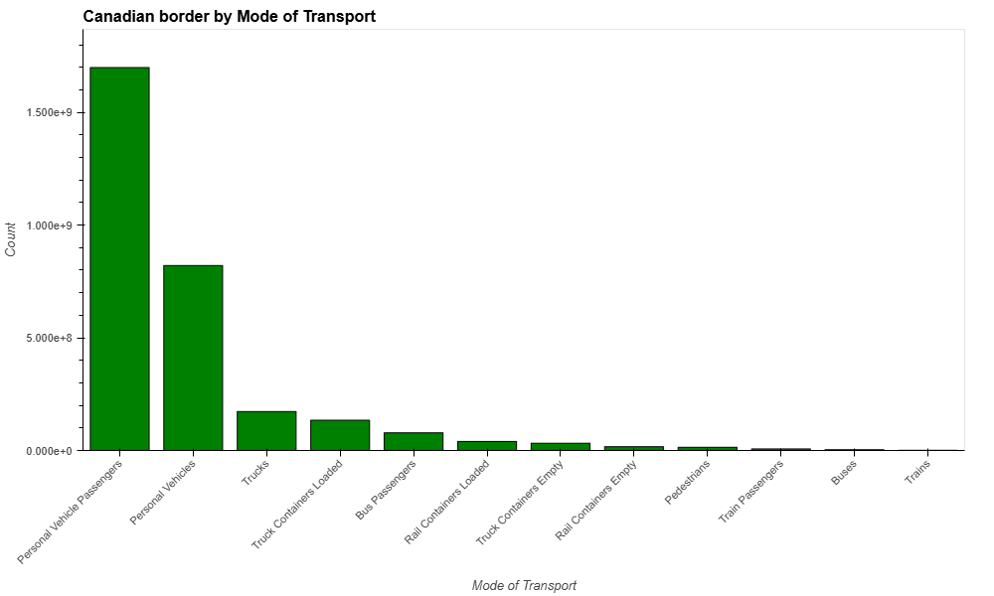
Canadian Border Crossings by Mode of Transport
Key Observations:
Personal Vehicle Passengers dominate with over 1.5 billion crossings indicating most vehicles carry multiple passengers.
Total freight-related crossings: 240 million crossings.

Slide 5
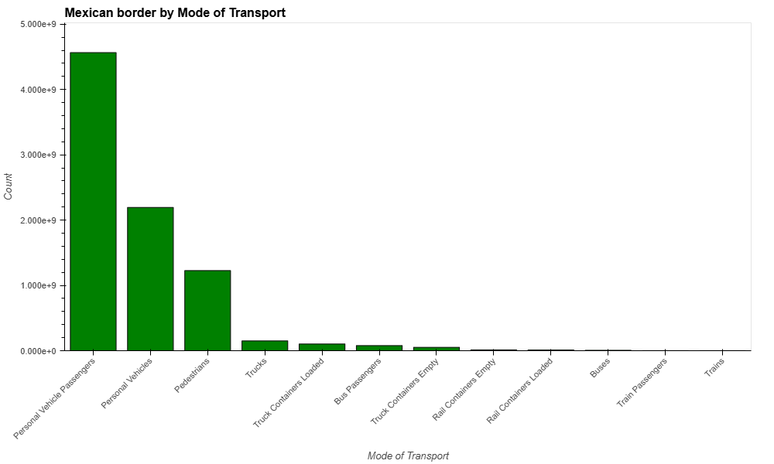
Mexican Border Crossings by Mode of Transport
Personal Vehicle Passengers dominate with over 4 billion crossings indicating most vehicles carry multiple passengers.
Total freight-related crossings: 190 million crossings

Slide 6

Map of U.S. Border Crossings
U.S. top 5 Busiest and Loneliest Ports of Entry

Slide 7
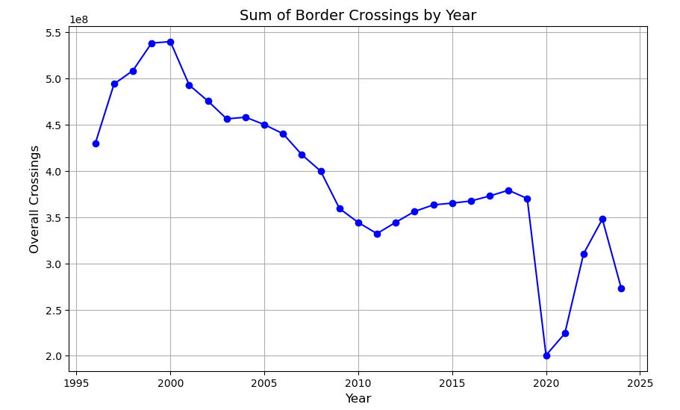
Initial Analysis
Initially reviewed the dataset using python/pandas. Looked over summaries of overall crossings by year, state, etc. Used matplotlib to summarize overall crossings by year included in dataset.
Data shows that border crossings have been at a decrease over time but has fluctuated.

Slide 8
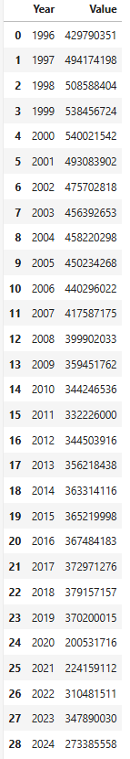
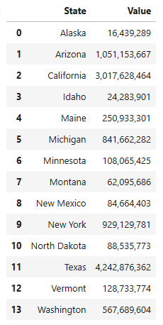
Initial Analysis
Overall, the dataset shows that Texas had the most crossings between 1997-2024.
Crossings were at an all time high in 2000 with the total recorded number being 540,021,542.

Slide 9
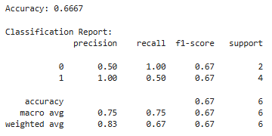
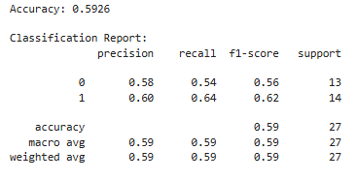
Future Predictions
Linear Regression:
Wanted to predict whether or not overall crossings will increase or decrease throughout the future.
Tested a few machine learning methods to predict an increase/decrease for future years. Used, summarized data by year/state and overall crossings. Then added column with % increase/decrease from year to year, and additional with increase/decrease result. Used linear Regression to predict from a sample. Accuracy was only 67%.
Tried to switch to Logistic Regression using the same data frame, but accuracy decreased.
Logistic Regression:

Slide 10
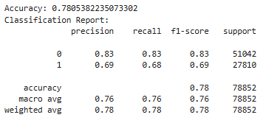
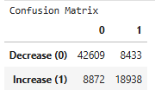
Future Predictions
Random Forest:
Decided to increase the size of the sample dataset instead of using summarized data frame, and switch machine learning model using Random Forest.
Used label encoder to update data to numeric so all columns can be included in the model.
Used similar python/pandas code from previous attempts to add columns with % increase, and general result increase/decrease.
Updates to model returned 78% accuracy
Confusion Matrix:
The model correctly predicted future decreases in 42,609 cases and was incorrect in 8,433 cases. For increases, the model predicted correctly in 18,938 cases and was incorrect on 8,872 cases.

Slide 11
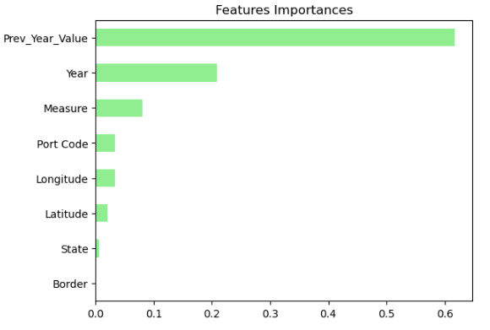
Random Forest
Concluded that the Random Forest was the most accurate method used when testing the data.
Reviewing the confusion matrix, the model predicted more decreases than increases in the future. Although crossings will fluctuate, we can conclude that as we move forward, the number of border crossings recorded will decrease.
Above are the features included in the model sorted by the importance that each served in the results.

Slide 12
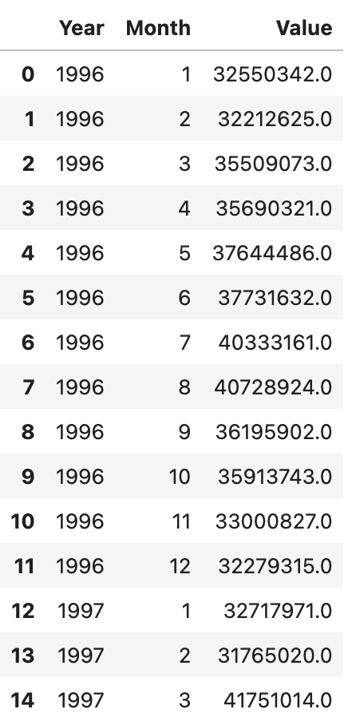
Process
I started the process by isolating the features that I wanted to use. I separated the year and month as they were combined in our original dataset. I used month to capture seasonality and year for a broad analysis of our data set. I also added the total measure of the crossings for each month starting in the year the dataset was created.

Slide 13
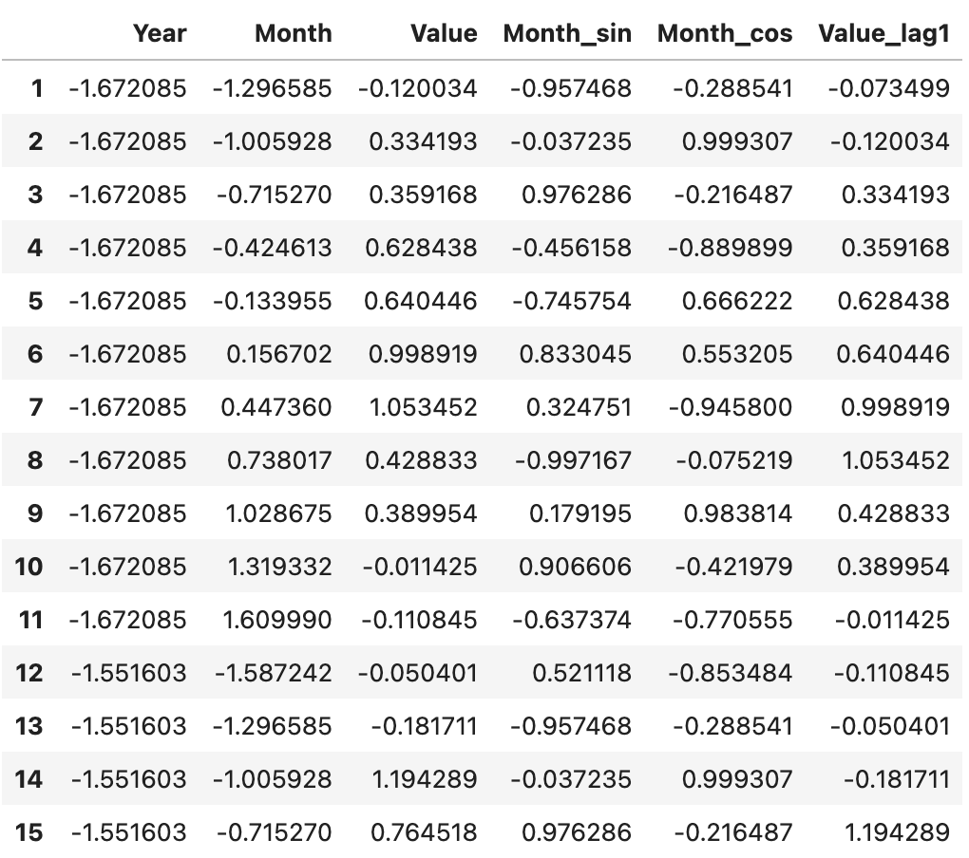
From the table I scaled the data for each column. Then I added cyclical features so that the model can better understand by representing months on a circular scale as points on a circular unit. I then added lag features of previous month so that the model has point of reference.

Slide 14
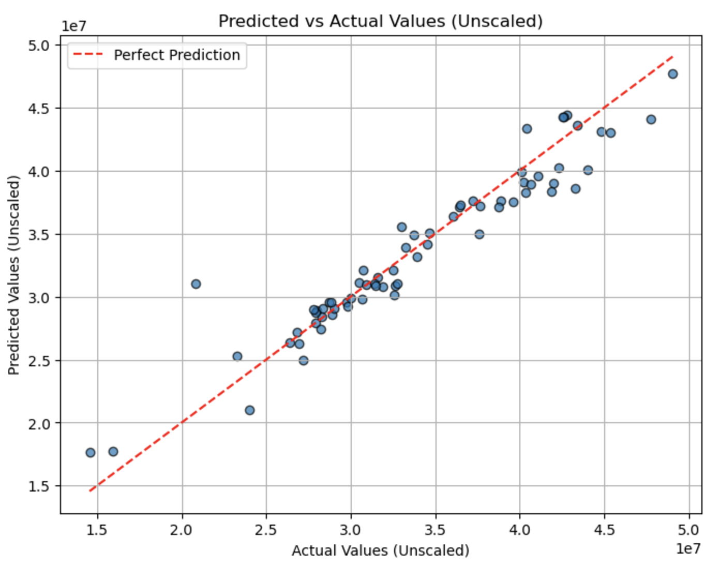
After creating my model and fitting, I was able to get an R2 score of 91%.
After plotting we can see that the model is pretty accurate. The points on the graph represent a single test instance of monthly data. While the red line represents a prefect prediction. This table visulaizes the relationship between actual data to predicted data.

Slide 15
Applications
The aim for this specific model is to predict monthly traffic volumes around the US border. We can use historical data to predict the fluctuation of border crossings throughout the year. Using this model, we can predict seasonal changes and contribute other factors that influence the data such as holidays and seasons.
The application of this ML can be used for allocating resources based on predicted increase of crossings and staffing levels to manage physical resources. Policy planning for anticipating and addressing congestions along with infrastructure investments on high traffic roads. Along with trade routes, we can use this model for better coordination with transport companies and reduce delays.

